Slide 1
Triolingo
Ethan Schillinger, H. Jacob Schenck, Joe Vossel

Slide 2
CONTENTS
Project Overview
Sprint Backlog
Conversation Demo
Sprint 2

Slide 3
Project Overview
Reminder of what we’re doing

Slide 4
Project Overview
Language learning app for non-beginners
Standard unit structure
Practice forming your own thoughts/ideas
Specialized scenarios

Slide 5
Sprint Backlog
Accomplishments and challenges

Slide 6
Sprint Backlog
Accomplishments
Basic framework for web app
Functional English chatbot
Flash card/quiz framework
Challenges
Finding good training datasets
Integrating chatbot with web app

Slide 7
Conversation Demo
Demonstration of specialized scenarios (English)

Slide 8
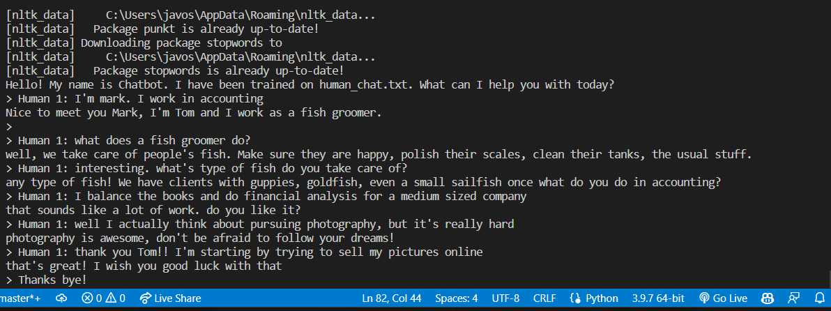
A little work to do

Slide 9
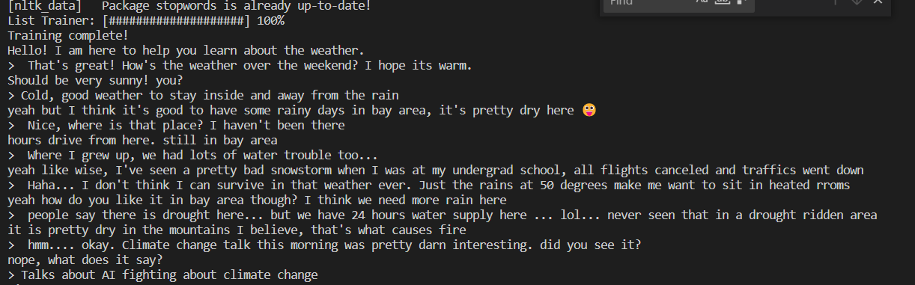
A little work to do

Slide 10
Sprint 2
Features we aim to implement

Slide 11
Sprint 2
Content creation for a few units
Russian chatbot
Chatbot integration
Improved website styling

Slide 12
Спасибо
Ethan Schillinger
Jacob Schenck
Joe Vossel

